Slide 1
Sorry I tried to download and made a mistake, pls delete
Ming Xin Bui

Slide 2
Interactive VOD System
Dr. Quang Duc Tran

Slide 3
Introduction
An IVOD system is capable of serving a large number of end users to concurrently access large number of repositories of stored data.
IVOD is an extension of VOD. In addition to the freedom of choosing movies, users can interact with videos and decide the viewing schedule (tricky play, i.e., fast forward, rewind, pause)
Components include set-top-box at the client’s site, the distribution network and the server

Slide 4
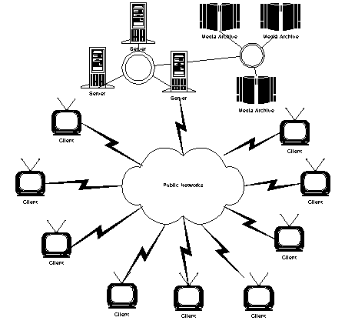
System Architecture
Centralized IVOD System places processing servers and media achieves in a single site as a central node.

Slide 5
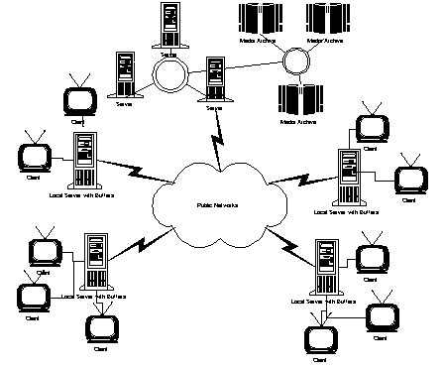
Client
Distributed IVOD System includes local processing servers and media servers. Clients’ requests are handled by local servers.

Slide 6
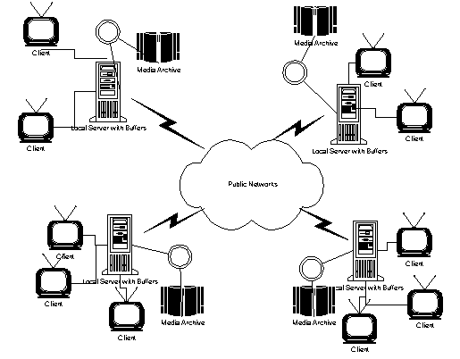
System Architecture
Distributed IVOD System

Slide 7
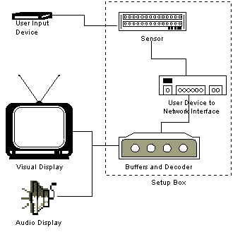
Client
User Input Device
Visual Display
Audio Display
Network Interface
Buffers and Decoder

Slide 8
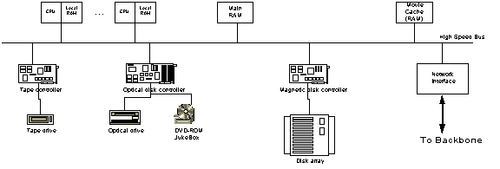
The Server
Tape drive
Tape controller
Disk array (Disk Scheduling, RAID)
NAT Traversal

Slide 9
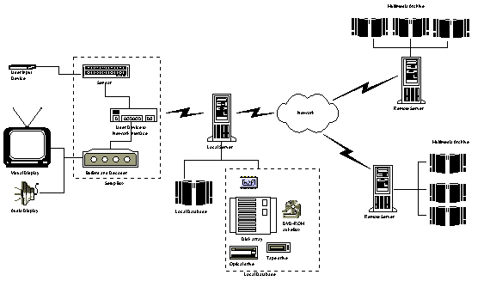
The overall architecture

Slide 10
Characteristics
Interactive Function (Play/Resume, Stop, Pause, Jump Forward, Jump Backward, Fast Forward, Slow Down, Reverse)
Quality of Service (Fast setup time, Continuity of media streams, Transparency of the involvement of multiple media streams)
Network (High speed networks, Latency, Jitter)

Slide 11
Introduction
Dr. Quang Duc Tran

Slide 12
About ME
Contact Information
Room B1-405
Department of Data Communication and Computer Network
School of Information and Communication Technology
Hanoi University of Science and Technology
E-mail: ductq@soict.hust.edu.vn
Tel: (+84) (4) 38682596

Slide 13
Aim of this Module
Describe the theory and operation of the major technologies and equipment of relevance to the media and information industries
Introduce you to the multimedia communications and its range of applications and networking infrastructures
Learn about different media types (text, images, speech, audio and video) and applications (VoIP, Video on Demand, multimedia electronic mail, interactive television and others)

Slide 14
Syllabus
Topic 1: Introduction to Multimedia Communication
Topic 2: Digitalization Principles
Topic 3: Text Processing
Topic 4: Digital Image Processing
Topic 5: Audio Processing
Topic 6: Video Processing
Topic 7: Multimedia Network
Topic 8: Quality of Service & Synchronization
Topic 9: RTP, RTCP & RTSP
Topic 10: SIP & H323

Slide 15
References
Jens-Rainer Ohm, “Multimedia Communication Technology”, Springer-Verlag Berlin 2014.
William Stallings, “Data and Computer Communication”, Prentice Hall – New Jersey 2007
J.D. Gibson, Editor, “Multimedia Communication”, Academic Press, San Diego, CA, USA, 2001.
L.L Ball, “Multimedia Network Integration and Management”, McGraw-Hill, 1996.

Slide 16
References
S.J. Gibbs, and D. C. Tsichritzis, “Multimedia Programming”, Addison-Wesley, New York, 1995.
W. Kou, “Digital Image Compression”, Kluwer publishers, London 1995.
S.J. Solari, “Digital Video and Audio Compression”, McGraw-Hill, 1997.

Slide 17
Evaluation Method
Final written exam (70%)
Held after the end of the lecturing period
Project/Midterm exam (30%)
Written in group of 2-4 students
Shall not have more than 10 pages (printed)
Includes application and presentation

Slide 18
Project Topics
Video On Demand service (Nginx)
Asterisk based Call Center (Asterisk)
Simple Video Chat Program (Socket Programming)
Video Conferencing System (BigBlueButton, Jitsi)
Media Center using KODI
FFMPEG: Video Codec Comparison
Video Streaming Server (Live555)
Video Recording (FFMPEG, RTSP)
Security: Secure RTP

Slide 19
INTRODUCTION
Dr. Quang Duc Tran

Slide 20
Multimedia Concepts
Multimedia:
Multimedia = Integration of multimedia data (text, speech, audio, video and images)
Multimedia Communication is originated in a confluence of two technological trends, i.e., Multimedia computing and Networking.
Applications: Video/Audio conferencing, education, entertainment, and monitoring of remote locations, etc.

Slide 21
Data vs. Signal
To be transmitted, data must be transformed to electromagnetic signals. Signal is continuously varying electromagnetic wave that may be propagated over a variety of medium, depending on spectrum.
Data can be analog or digital. Analog data takes on continuous values on some interval (e.g., voice and video). Digital data takes on discrete values (e.g., text, integer).
Signals can be analog or digital. Analog signal have an infinite number of values in a range; Digital signals can have only a limited number of values.

Slide 22
Data vs. Signal (Cont.)
To achieve longer distances, the analog transmission system includes amplifiers that boost the energy in the signal. The amplifier also boosts the noise components. The signal becomes more and more distorted.
For analog data, such as voice, a bit of distortion can be tolerated. For digital data, the amplifier introduce errors.
For analog signal, the transmission system has repeaters. The repeater recovers the digital data from analog signal and generate a clean analog signal.

Slide 23
Periodic vs. non-periodic signal
A periodic signal completes a pattern within a measurable time frame, called period, and repeats such a pattern over subsequent identical periods. One full pattern is known as a cycle.
A non-periodic signal changes without exhibiting a pattern or cycle that repeats over time.
In data communications, we commonly use periodic analog signals and non-periodic digital signals.

Slide 24
Multimedia Data
Text: Block of characters, each represented by a fixed number of binary digits (bit), known as codeword.
Still images (e.g., graphics, pictures): Two dimensional blocks of picture elements represented by a fixed number of bits
Sound and Video: Type of signal is known as an analogue signal and varies continuously with time (e.g., telephone conversation can last for several minutes while a movie (audio + video) can last for a number of hours).
Animation: Sequence of graphics.

Slide 25
Media Type Classification
Captured vs. synthesized media
Captured media (natural): information captured from the real world (examples?).
Synthesized media (artificial): information synthesized by the computer (examples?).
Discrete vs. continuous media
Discrete media: spaced-based, media involves the space dimension only (examples?).
Continuous media: time-based, media involves both the space and the time dimension (examples?)

Slide 26
Media Type Classification
Sound
Video
Animation
Continuous
Continuous
Image
Text
Graphics
Discrete
Discrete
Captured from real world
Synthesized by computer

Slide 27
Text
Plain text
Unformatted
Characters coded in binary form
ASCII code
All characters have the same style and font
Rich text (RTF)
Formatted
Contains format information besides codes for characters
No predominant standards
Characters of various size, shape and style, e.g., bold, colorful

Slide 28
Text Coding & Compression
Text coding
ASCII
Standard code table (7 bit – 128 characters)
Extended code table (8 bit – 256 characters)
Unicode
16 bit system (65,536 characters)
> 110,187 graphical, formatting and control characters
Text compression
Statistical compression: Huffman code
Compression using dictionary: Lempel-Ziv
Compression rate: 1/2 - 2/3 document size

Slide 29

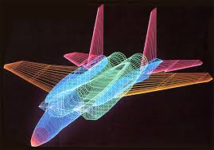
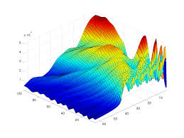
Graphics
Revisable document that retains structural information
Consists of objects such as lines, curves, circles, etc.
Usually generated by graphic editor of computer programs, such as Corel Draw, Adobe Illustrator

Slide 30
Still Image
2D matrix consisting of pixels
Pixel: smallest element of resolution of the image
One pixel is represented by a number of bits
Pixel depth: the number of bits available to encode the pixel
Have no structural information
Possibly scanned and synthesized still image
Computer Software
Synthesized image
Camera
Capture and A/D conversion
Scanned image

Slide 31
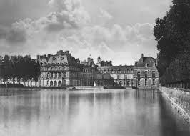
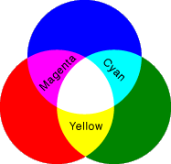

Still Image (Cont.)
Examples of images
Binary image: pixel depth 1
Grayscale image: pixel depth 8
Color image: pixel depth 24
Pixel (RGB)

Slide 32
Graphics vs. Still Image
Graphics
Revisable documents
Document format retains structural information
Semantic content is preserved in presentation
Described by objects
Images
No revisable
Document format is unaware of any structural information
Semantic content is NOT preserved
Described as bitmaps formed of individual pixels

Slide 33
Image Compression
Lossless compression
Run-Length coding (RLC)
Lempel-Ziv coding
GIF, BMP, TIFF
Lossy compression
Transform coding
Chroma sub-sampling
JPEG, JPEG2000

Slide 34
Video
Video - moving images or moving pictures
Captured or Synthesized
Consists of a series of bitmap images
Frame rate: the speed to playback the video
NTSC (US, Japan): 30 frames/s
PAL (EU): 25 frames/s
SECAM (France): 24 frames/s
HDTV: 50/60 frames/s
UHDTV: 120 frames/s

Slide 35
Video vs. Animation
Both images and graphics are displayed as a succession of view, which creates an impression of movement.
Video - moving images or moving pictures
Captured or Synthesized
Consists of a series of bitmap images
Animation - moving graphics
Generated by computer program
Consists of a set of objects
The movement of the objects can be computed

Slide 36
Video Compression
International Telecommunication Union (ITU-T)
H.261: ISDN Video Phone (px64 kb/s)
H. 263: PSTN Video Phone (<64 kb/s)
H.26L: A variety of applications (<64 kb/s)
Internet Video Application, VOD, Video Mail
International Organization for Standard (ISO)
MPEG-1 Video: CD-ROM (1.2 Mb/s)
MPEG-2 Video: SDTV, HDTV (4-80 Mb/s)
MPEG-4 Video: A variety of applications (24-1024 kb/s)

Slide 37
Sound
Sound (e.g., speech, music, noise)
Analog 1-D time-based signal
Vibration that propagates as a typically audible mechanical wave of pressure and displacement through a medium such as air or water.
Sound wave: Sinusoidal planes wave, which has the following properties
Frequency
Wavelength
Amplitude
Human ear: 20-20,000 Hz. The upper limit decreases with age

Slide 38
Digital Audio
Audio signal that is encoded in digital form
Sampling
Quantization
Sampling rate
Telephone: 8 kHz
CD-audio: 44.1 kHz
Quantization
Speech: 8 bit
CD-audio: 16 bit
Audio Compression
Lossless compression: FLAC, Apple Lossless, MPEG-4 ALS
Lossy compression: MP3 (50-60% of original size)

Slide 39
A Simple Data Communication Model
Source generates the data to be transmitted (Examples?)
Transmitter transforms and encodes the information to produce electromagnetic signals that can be transmitted across some sort of transmission system.
Transmission system can be transmission line or a complex network connecting source and destination
Receiver accepts the signals and convert them into a form that can be handled by the destination device.
Destination takes the incoming data from the receiver.
Source
Transmitter
Transmission System
Receiver
Destination

Slide 40
Communication Tasks
Transmission system utilization Interfacing Signal generation Synchronization Exchange management Error detection and correction | Flow control Addressing Routing Recovery Security Network management
Notes:
Transmission system utilization refers to the need to make efficient use of transmission facilities. Congestion control techniques may be required to assure the system is not defeated by excessive demand of transmission services.
Interfacing: a device must be able to communicate with the transmission system.
Synchronization: the receiver must be able to determine when the signal begins to arrive and when it ends. It must also know the duration of each signal element.
There are a variety of communication requirements might be collected and exchanged under exchange management.
Flow control ensure the receiver is not defeated by a faster sender.
Recovery is needed in situations where an information exchange such as file transfer is interrupted due a fault somewhere in the system. The activity should be resumed at the point of interruption.
Security: Only intended party actually receive the data.
Network management is needed to configure the system, monitor its status, react to failures and overload.

Slide 41
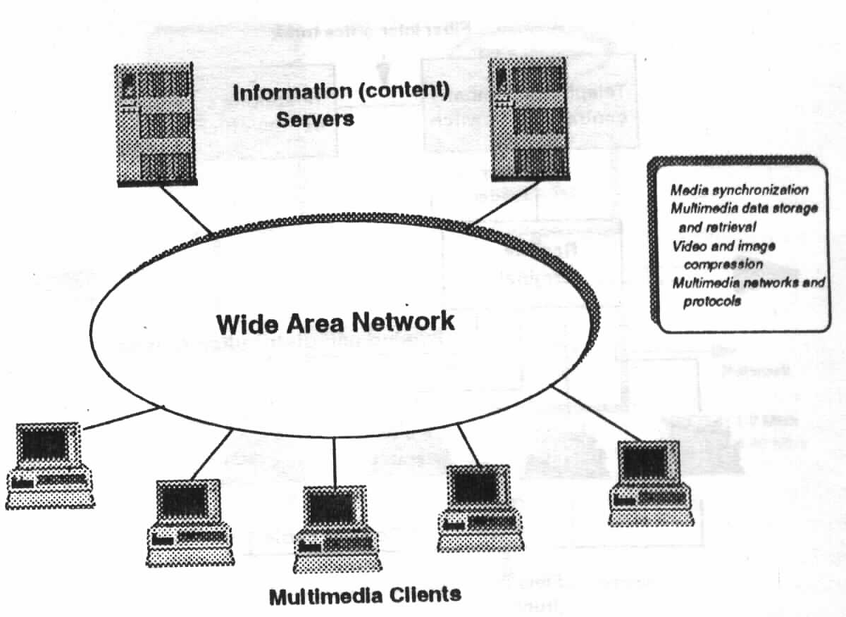
Distributed Multimedia System
Distributed Multimedia System involves transmission and distribution of multimedia information on the network.
Multimedia Servers
Silicon Graphic
HP Media Server
Multimedia Networks
PSTN/Data Network etc.
Multimedia Clients

Slide 42
Distributed Multimedia System (Cont.)
Live media transmission system
Capture, compress, and transmit the media on the fly (example?)
Send stored media across the network
Media is pre-compressed and stored at the server. This system delivers the stored media to one or multiple receivers (example?)
Differences between the two systems
Media capture: Real-time media capture vs. pre-stored media.
Media compression: Real-time/off-line compression?, compression can be adjusted during transmission?

Slide 43
Distributed Multimedia System (Cont.)
Requirements of networked multimedia applications
Delay requirements
Quality requirements
Satisfactory quality of media presentation
Synchronization requirement
Continuous requirement
Can tolerate some degree of information loss
Challenges of distributed multimedia system
Conflict between media size and bandwidth limit
Conflict between the user requirement of multimedia application and the best-effort network.
How to meet different requirement of different users?

Slide 44
Multimedia Server
Tape storage
Multimedia Servers
Data storage and retrieval
Media synchronization
Video/Audio Compression
Requirements
High performance
High reliability
CPU
Tape
Controller
System bus
Network
Disk
Controller
Network
adapter
High-speed
bus
Disk on-line
storage
MPEG-1: 1-2 Mb/s
MPEG-2: 2-40 Mb/s

Slide 45
Multimedia Equipments
Digital equipments:
Computers
A/D, D/A converters for Video and Audio.
Analogue equipments:
Video camera,
Microphone, Speaker,
Tape player/recorder.
Synchronization equipments:
Support time synchronization.
Interactive equipments:
Display, mouse, keyboard etc.

Slide 46
Multimedia Networks
Telephone Networks:
Public switched telephone networks (PSTNs): initially designed to provide speech services, now can support multimedia applications due to the advances in Digital Signal Processing hardware and software.
Data Networks: initially supported data applications (e-mail/ftp), now support much complex multimedia applications.
Broadcast Television Networks: Broadcast TV
Broadband Multiservice Networks: Multiservice.

Slide 47
Multimedia Operating System
Multimedia operating system provides a comfortable environment for the execution of programs, and ensures effective utilization of the computer hardware.
Multimedia Applications
Multimedia I/O
Manager
Stream
Handlers
Multimedia Device
Manager
Physical Device
Driver
Stream and
Synchronization manager
Multimedia I/O Drive
Audio/ video codec
Hard disc
drive
Optical
drive
CD ROM
drive
Analog video
NTSC, PAL
Analog
audio
PCM
Monitor

Slide 48
Multimedia Operating System (Cont.)
MMOS Requirements:
Soft real-time applications: statistical guarantees
Interactive applications: no absolute performance guarantees, but low average response times
Throughput-intensive application: no performance guarantees, but high throughput.
Fair, Proportionate resource allocation: Divide resources according to application requirements.
Application Isolation: Preventing misbehaving or overloaded application from effecting others (e.g., overloaded web server should not affect streaming media server).
Notes:
Hard real-time applications are designed for specialized purposes, where even smallest amount of latency can make the difference between life and death. These applications include triggering airbag deployment in car crashes or monitoring the heart rate of a patient during an operation.
Soft real-time applications: no absolute performance guarantees can be made.

Slide 49
Multimedia Operating System (Cont.)
Root
Root
I
TP
SRT
I
SRT
TP
Http
SRT
Class-specific Schedulers
33%
33%
33%
33%
66%
Audio
Video
D1
D2
Audio
Video
C
Class-Independent
Scheduler
20%
80%
50%
50%
20%
80%
FCFS
CPU Scheduler
Packet Scheduler
Disk Scheduler

Slide 50
Multimedia Applications
Multimedia Information Systems: Multimedia Database, Information hypertexts, Hypermedia, Electronic books, Multimedia expert systems, etc.
Multimedia Communication Systems: VOIP, Audio-video Communication, Computer-supported collaborative works, Videoconferencing, IPTV, Streaming media and Multimedia Teleservices, etc.
Multimedia Entertainment Systems: Game, 3D computer games, Multimedia design, Multiplayer networks, Interactive audiovisual productions, etc.

Slide 51
Multimedia Applications (Cont.)
Multimedia Educational Systems: E-Books, E-learning, Flexible teaching materials, Simulation education systems, etc.
Multimedia Business Systems: Electronic commerce, Marketing, Multimedia presentation –PR, Virtual shopping, etc.

Slide 52
Multimedia Application Environment

Slide 53
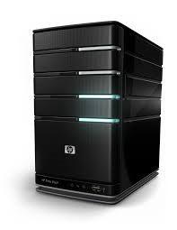
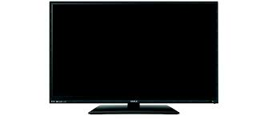
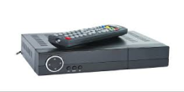
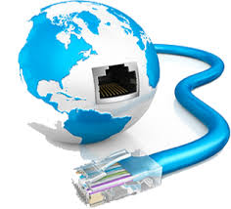
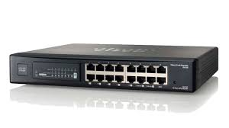
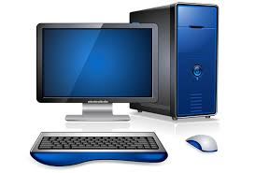
Example (Video on Demand)
ADSL
STB
Media Server
Authentication
/Billing Server
CATV
STB
Router
Streaming Server
Modem
STB
Web Server

